Slide 1
Introducing NativeScript
Notes:
Hello everyone. Welcome to my talk on NativeScript. An open source framework to build mobile apps.

Slide 2

Now presenting – Sebastian Witalec
Solution Engineer and Technical Evangelist for Telerik
Working with the Dev community in London:
International Developers
Software Architecture & Mentorship
NativeScript Insiders London (soon)
Notes:
A little bit about me
My name is Sebastian Witalec.
I work as a Solution Engineer and Technical Evangelist for Telerik.
I am engaged with various Dev communities in London, such as the International Developers group (also know as ID in London), Software Architecture & Mentorship Group and soon to launch a NativeScript Insiders group in London.
My background is primarily in Data Quality solutions, think software that handles data of questionable quality and makes something meaningful with it.
My challenges were around the performance of the data processing workflows. I didn’t have to care about the visual part of the solution. If we told the users to use IE 6 to access the dashboard, then that is what they would use. Except we didn’t ☺
I’ve recently transitioned into mobile development and that really put me out of my comfort zone. I have a newfound respect for the UX and I had to learn how to solve a completely different set of challenges.
<Before the next slide>
This is enough about me.
Here are the things that I am going to talk about

Slide 3
I AM GOING TO TALK ABOUT
The mobile OS Landscape
The cross platform development problem
NativeScript introduction
Technical overview:
High level architecture
Technical implementation
UI building blocks
Open Source
Roadmap
Notes:
<Before the next slide>
Lets start with a quick overview of the mobile platforms jungle

Slide 4
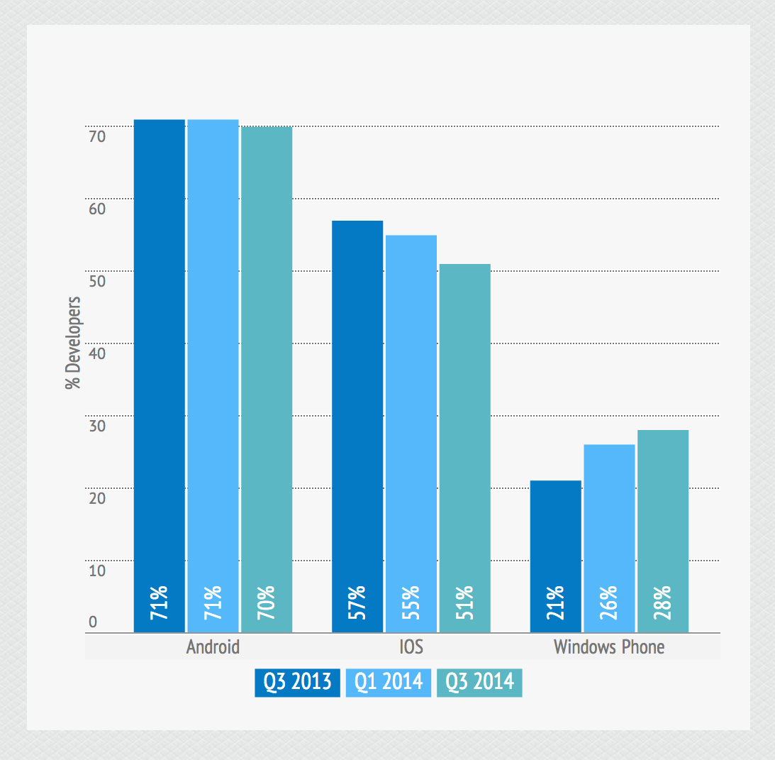
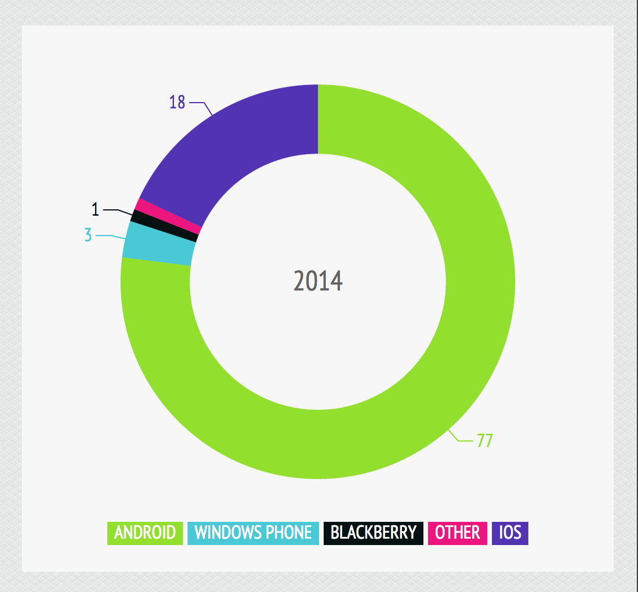
MOBILE PLATFORM JUNGLE
Source: Developer Economics Q3 2014 | www.developerecomics.com/go | Licensed under Creative Common Attribution 3.0 License
Notes:
The Android and iOS continue to dominate developer choice. Android has a larger audience while iOS is easier to monetize. It’s therefore easy to forget that there is a third player.
Microsoft is successfully recapturing the lost ground. About 28% of surveyed developers said that they now support Windows Phone too.
Supporting the three main platforms will give you an almost complete coverage of the smartphone market. 98% to be precise.
<Before the next slide>
But the coverage by itself won’t pay your bills. This is why we should take a look at the number of apps in the marketplaces and the money associated with each.

Slide 5
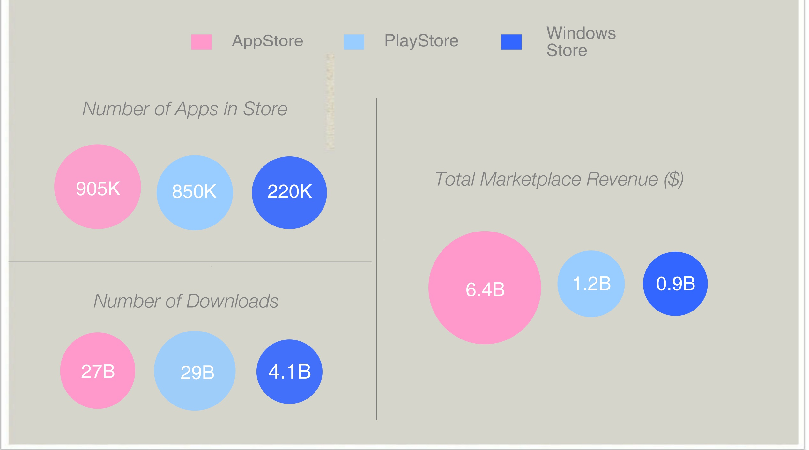
MARKETPLACE CURIOSITIES
Source: http://www.gadgetmilk.com/features/mobile-phone-os-shares-apps-statistics/
Notes:
There are almost 4 time less apps in the windows marketplace, yet the Windows phone total revenue is only 20% smaller than Playstore’s total revenue
<Before the next page>
So what does this mean to an individual developer?

Slide 6
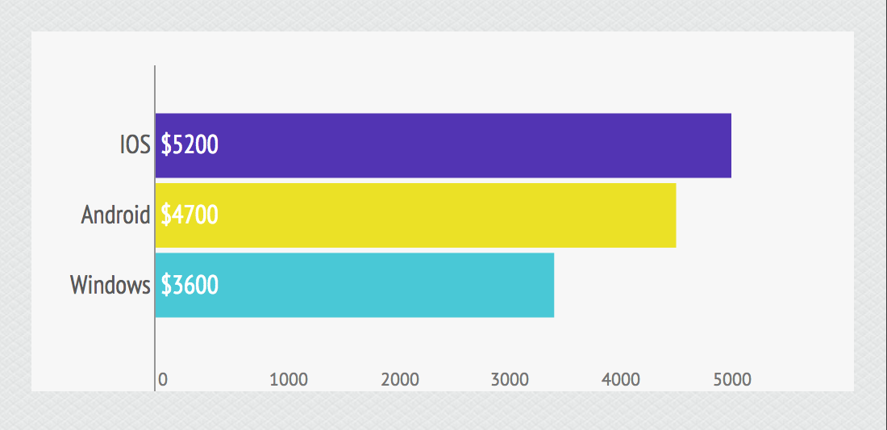
AVERAGE DEVELOPER REVENUE PER PLATFORM
Source: Developer Economics Q3 2013 | www.developerecomics.com/go | Licensed under Creative Common Attribution 3.0 License
Notes:
Each of the marketplaces offers a big opportunity to earn between $3600 to $5200 a month.
However you could double or triple that if you target all of those platforms.
<Before the next slide>
As expected a lot of mobile developers recognized this opportunity and target multiple platforms.

Slide 7
SUPPORT FOR MULTIPLE PLATFORMS
Source: Developer Economics Q3 2014 | www.developerecomics.com/go | Licensed under Creative Common Attribution 3.0 License
Notes:
However that number has shrunk in the last 12 month.
From 2.9 targeted platforms a year ago, to 2.5 platforms 6 months ago and finally to 2.2 according to the latest report.
And if we exclude game developers, then this figure is as low as 1.75.
<Before the next slide>
You see… Mobile app development is like a 3 way chess game,

Slide 8

3 WAY DEVELOPER EXPERIENCE
!PICTURE OF 3 WAY CHESS!
Notes:
Mobile app development is like a 3 way chess game – except (where) you make all the moves. You get more of the board to conquer, however the game complexity increases and each move has to be analyzed from yet another angle.
Often you will find yourself in unexpected (and complex positions) which will take a lot effort to handle.
<Before the next slide>
Yet still I wish mobile development was as easy as a 3 way chess game, because
You see each chess piece follows a predictable pattern of behaviour , while mobile APIs do not.

Slide 9

THE PROBLEM
Notes:
Your company has to write and maintain multiple implementations for the same problem.
Teams write and have to support the same apps multiple times.
There is a good chance that bugs reported on one platform also exist on the others but remain unnoticed.
Apps that are meant to behave identically on all platforms may exhibit subtle differences due to differing implementations.
Shipping new features at the same time on all platforms is really hard.
<Before the next slide>
Let’s see why this is so difficult?

Slide 10



CROSS PLATFROM DEVELOPMENT
Objective-C
Java
XAML, C#
Xcode
Eclipse
Visual Studio
Mac OS X
Windows
Notes:
If I need to build for Apple I need to learn Objective-C language, install Xcode and develop on Mac OS X.
On the other hand to develop for Android, I need to use Java and set up Android SDK with Eclipse.
(Last time I tried that it took me almost a day to set up Eclipse and every time I was running my hello world app it would take forever to launch the emulator.)
Last but not least.
Developing for Windows Phone requires: me to learn XAML and C# and run Visual Studio on Windows 8.
Overall native development for all platforms would require me to use multiple machines, learn multiple languages and become expert in all available APIs.
Another problem that we are facing with are different development concepts (architectural patterns). For example: developing for Windows Phone gives me MVVM, which is completely different to the architectural patterns I would use to develop for Apple and Adroid.
This is not optimal and not very productive and requires a significant investment in knowledge of three different operating systems, languages, IDEs, APIs and marketplaces.
<Before the next slide>
On the other hand

Slide 11

CROSS PLATFROM DEVELOPMENT
hybrid
Objective-C
Java
XAML, C#
HTML, CSS, JS
Xcode
Eclipse
Visual Studio
Multiple
Mac OS X
Windows
Multiple
Notes:
On the other hand we have hybrid app development with HTML, CSS and JavaScript; Which allows me to target multiple platforms in one go.
But then we need to sacrifice the smooth and beautiful User Experience that we grew accustomed to.
Don’t get me wrong you can still build quite amazing apps with the hybrid approach, but in some cases this might not be enough.
<Before the next slide>
There must be a better way.
<much simpler to access API>

Slide 12
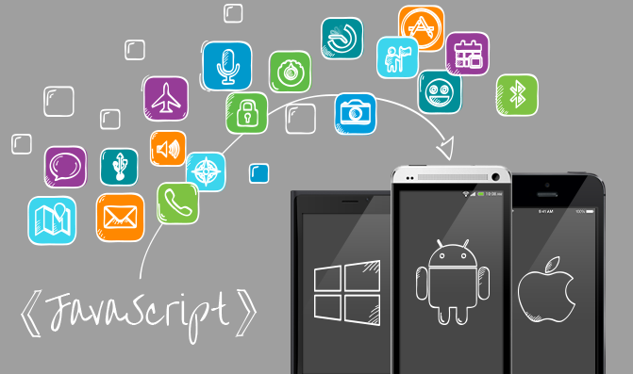
THE BIRTH OF THE “IDEA”
Notes:
This is why we decided to create a cross-platform framework for building native apps with native UX running on most platforms and devices.
We envisioned a framework that will allow you to access native platform APIs and use native UI components with just good old JavaScript – think a single code base running on multiple platforms.
<Before the next slide>
First point of call – killer project name. We set up a contest and came up with names like:

Slide 13
NAMING DILEMMA
JS Family
KempoJS
Cross Family
CrossFly
Other
Conjoin
NaturalizeJS
UniversalJS
NativeJS
CrossFire
CrossCompile
ScriptBridge
ScriptGap
Serious Candidate
xCompile
J2SN
Notes:
First we came up with names like KempoJS, NaturalizeJS, UniversalJS and NativeJS
But we are after something that is much more than just a JavaScript library.
Then CrossFly, CrossFire and CrossCompile crossed our minds, but we decided to cross these names out.
We also considered Conjoin, JS2N, ScriptBridge and ScriptGap. They had an interesting ring to them, but we needed something special.
We seriously considered xCompile
<Before the next slide>
but we kept looking.

Slide 14

THE INTRODUCTION TO
Notes:
Without further ado.
I give you NativeScript
The NativeScript framework let’s you use JavaScript to build mobile applications utilizing platform specific, native API calls.
It’s supports iOS, Android and soon Windows Universal.
In other words with NativeScripts you get the full Native experience and no excuses.

Slide 15
DEMO

Slide 16
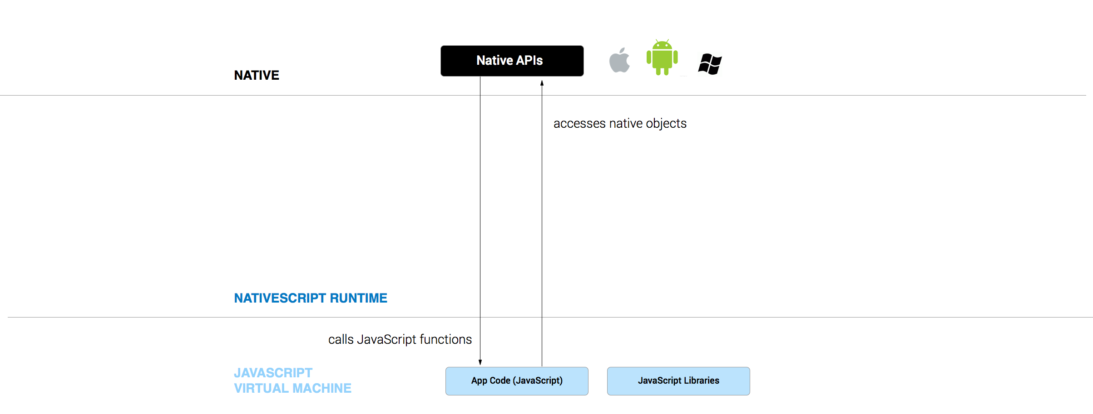
Notes:
This is going to be like trying to explain a magic trick, so I hope it won’t take the magic out of it.
NativeScript is not just a set of libraries, but more of a Runtime that enables you to call native APIs: for Android, iOS and Windows Universal
It is made of several major parts:
A JavaScript Virtual Machine – to interpret and execute the JavaScript code. Then we have:
<Before the next slide>
A Bridge

Slide 17
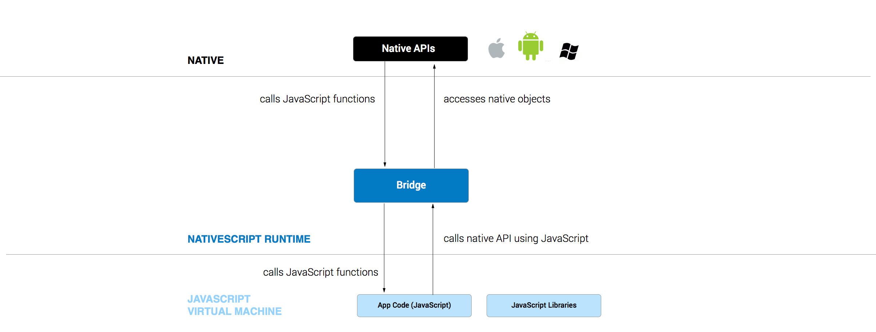
Notes:
A Bridge
to translate the JavaScript calls to the underlying platform-specific APIs. The bridge module includes:
<Before the next slide>
A set of bindings

Slide 18
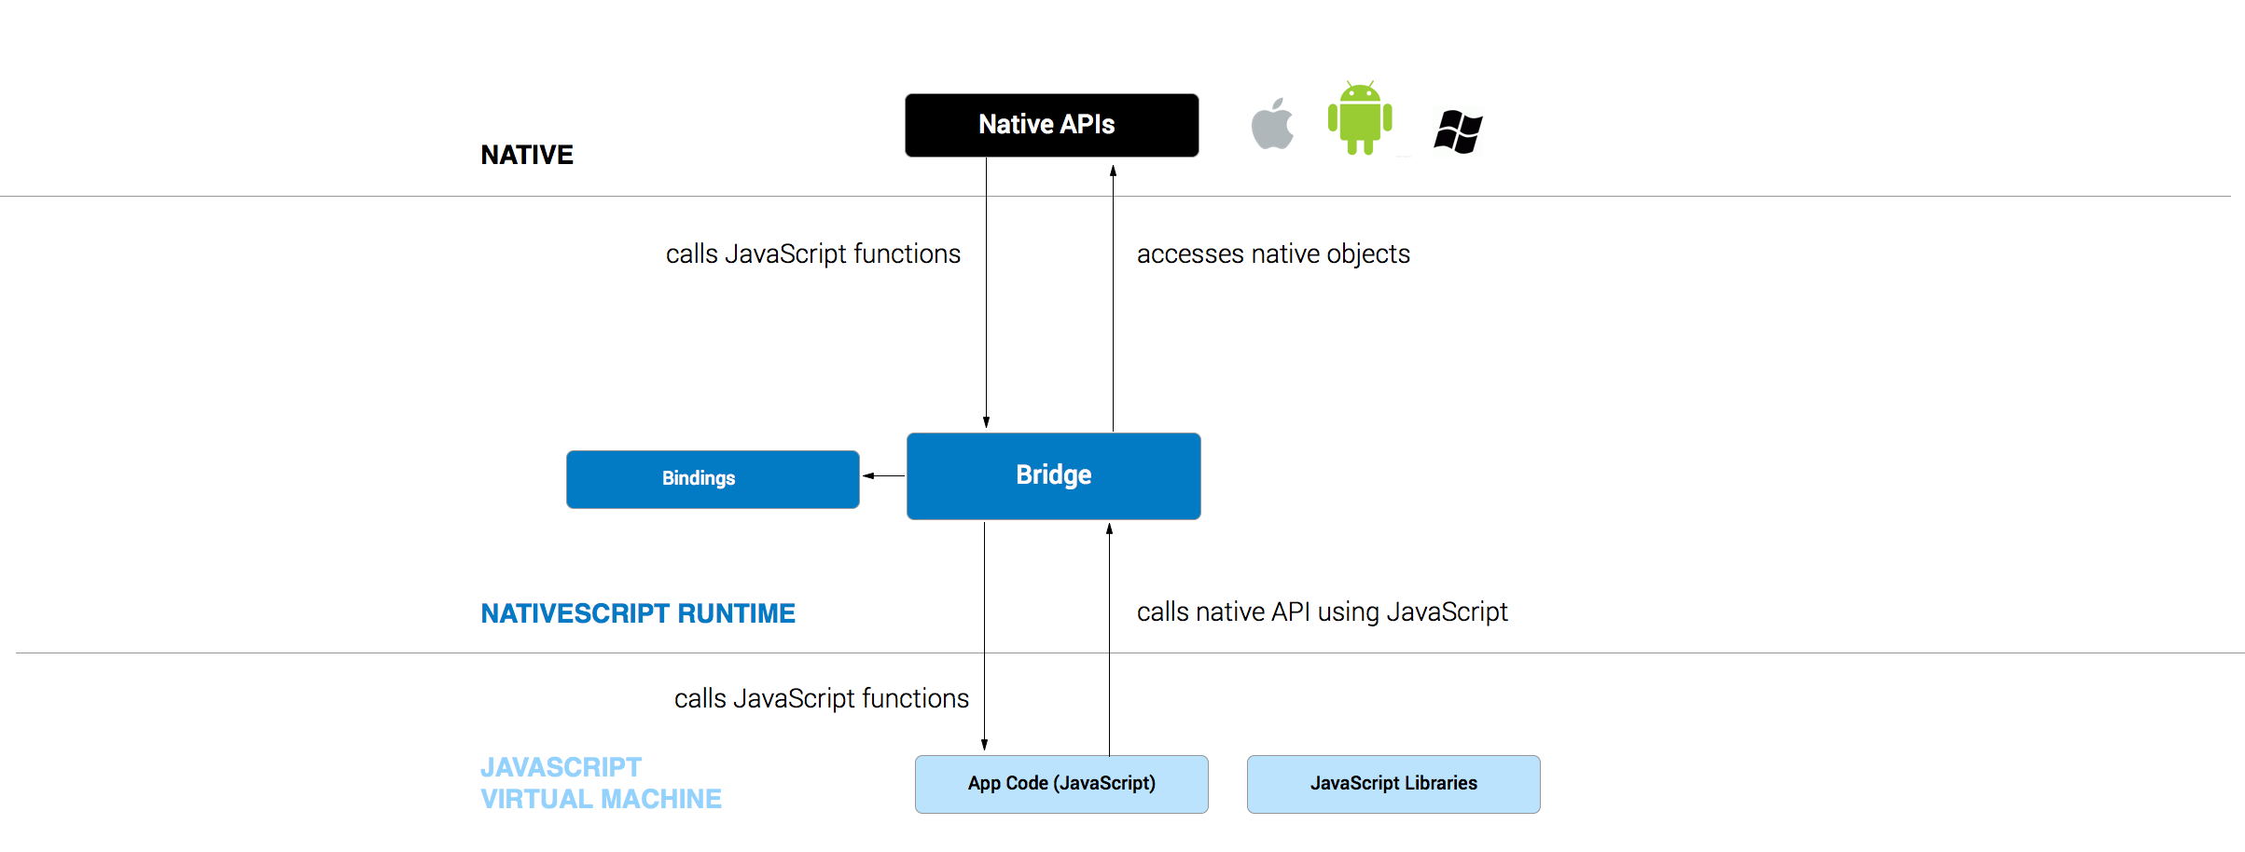
Notes:
- A set of Bindings
Used to link your JavaScript methods to their corresponding native equivalents.
<Before the next slide>
As well as a Marshalling service

Slide 19
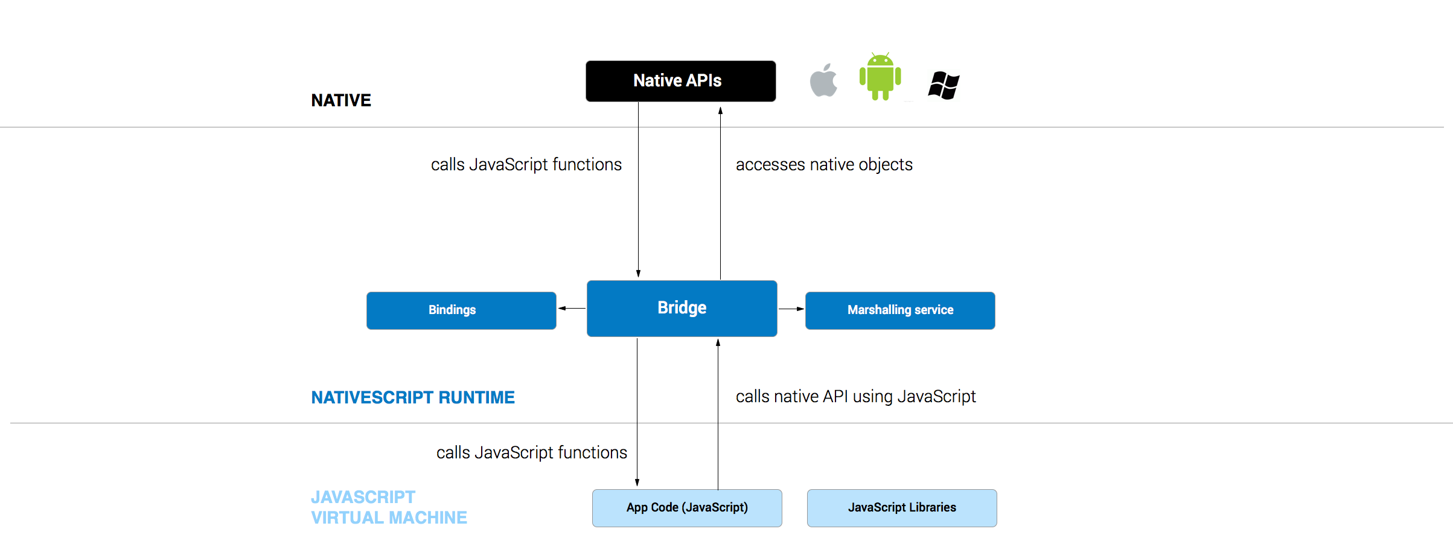
Notes:
- A Marshalling service
that handles data transfer to/from JavaScript to/from native types.
<Before the next slide>
Then we have the Call Dispatcher

Slide 20
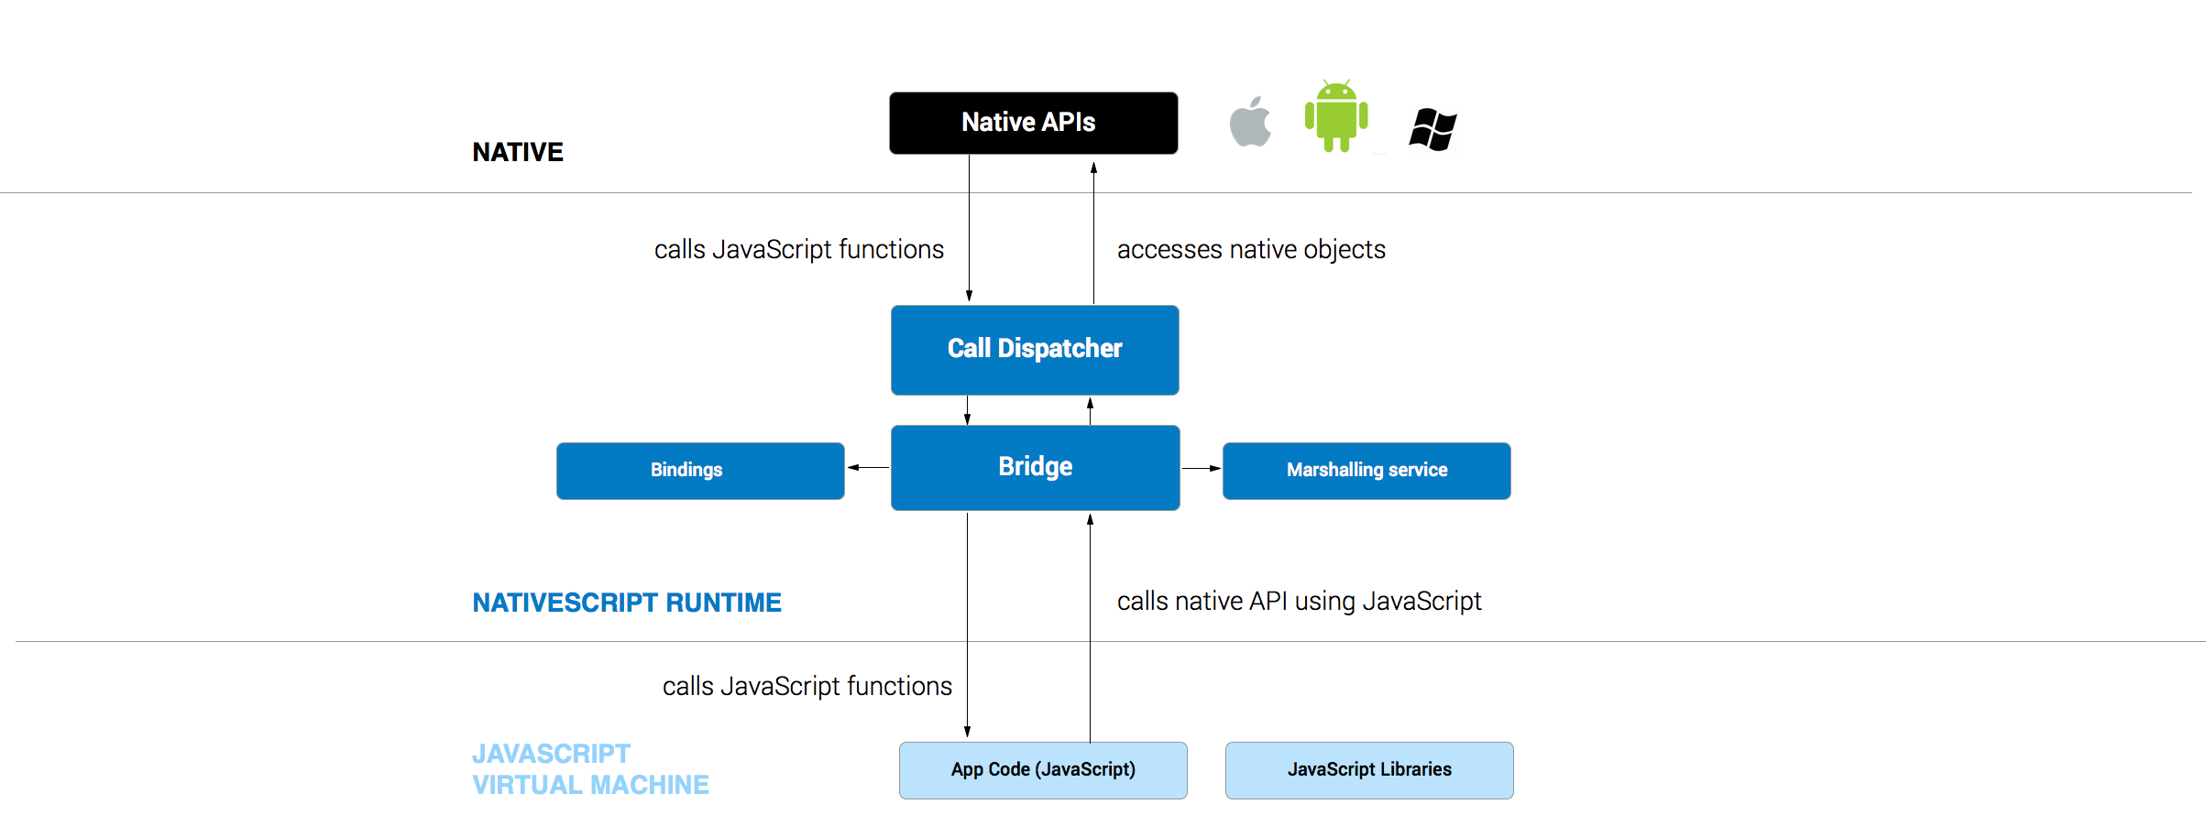
Notes:
Then we have the Call Dispatcher –
that makes the actual call to the Native API and takes care of passing down the results.
<Before the next slide>
Now let’s have a look at a piece of JavaScript code calling Android API and see what happens in there.
For your information the JavaScript Virtual Machines are:
For Android – Googles v8
For iOS – WebKit’s JavaScriptCore

Slide 21
Calling Android API
V8 JavaScript Engine
var file = new java.io.File(path);
Notes:
var file = new java.io.File(path);
This is still a JavaScript code.
Here is what happens with this call:
The JavaScript Virtual Machine (or in this case v8 JavaScript Engine) evaluates the code.

Slide 22
Calling Android API
V8 JavaScript Engine
var file = new java.io.File(path);
Marshalling Service
Native
Android
java.lang.String
Notes:
The Marshalling service converts the path value, from the JavaScript String to a java.lang.String object.

Slide 23
Calling Android API
V8 JavaScript Engine
var file = new java.io.File(path);
Marshalling Service
Native
Android
java.lang.String
Binding
java.io.File()
Notes:
The Bindings determine the corresponding native method to call. As a result finding the native constructor for the java.io.File class.

Slide 24
Calling Android API
V8 JavaScript Engine
var file = new java.io.File(path);
file = FileProxy
Marshalling Service
Native
Android
java.lang.String
Binding
java.io.File()
Call Dispatcher
java.io.File
Notes:
The call dispatcher executes the call with a dual result:
On Android Side: we get a new instance of the native java.io.File class
On NativeScript Side: we get a custom JavaScript Object serving as a proxy to the native Android’s object
When a method is called on this proxy it is delegated to the underlying native object instance.
<Before the next slide>
It is really great that you can access native APIs straight form JavaScript.
But I can hear you think. … this still doesn’t solve the problem of me having to learn all those Platform APIs.
But this is just the foundation of the NativeScript framework.
The next logical step was to create a platform agnostic abstraction layer.
We call it the Native Script Modules Layer or in short the NSM Layer.

Slide 25
Native Script Modules Layer
NSM Layer
(JavaScript)
UI Abstraction
File System Abstraction
Device sensors
Local Storage
Push Notifications
Launchers, Choosers
Localization,
Globalizations
Other…
Runtime
Native UI
Components
JavaScript
Running on VM
User Interaction
Handled by Native platform
Hardware Access
Handled by Native platform
Native iOS application
Native iOS application
Native iOS application
Notes:
We call it the Native Script Modules Layer or in short the NSM Layer.
Thanks to NativeScript modules you no longer need to think on how to perform the same operation using 3 different Platform API’s, but instead you can concentrate on the what and not how. (You can trust a NativeScript module to know how to call each of the Platform Specific APIs.)
The NSM layer translates to the platform specific code executed at runtime and from there using the mechanism we covered a moment ago this results in Native API calls.
The NSM layer provides you with many modules like:
UI abstraction, File system abstraction, device sensors, hardware access, local storage and many more.
To show you why this is very important.
<Before the next slide>
Let’s consider our file example
Let’s consider downloading a JSON from the internet – you will need some HTTP-access APIs and these APIs are different on each platform.
Launchers – default native screens, for camera. Phone
Choosers – default native selecting phone book contacts scenario or share item, import existing picture

Slide 26
Cross-platform API
In Cross platform abstraction
Cross-platform
var file = new File(path);
At runtime, executed on the JS engine.
On Android
On iOS
File file = new java.io.File(path);
NSFileManager.defaultManager();
fileManager.createFileAtPathContentsAttributes(path);
Notes:
The implementation that lies behind this function is different for each platform, but it is the module that takes care of the specific implementation.
This way you can write code once and execute it on each of the supported platforms.
<Before the next slide>
What I am showing you here today is designed to overcome one of the biggest issue of cross platform development.

Slide 27

Notes:
JavaScript to rule them all?

Slide 28

Performance
Notes:
Hearing how NativeScript works you are probably wondering about the performance of NativeScript vs Purely Native.
Obviously every additional layer of abstraction comes at a price.
We did some testing and rough measurements show about 10% penalty vs the same functionality implemented in native code.
To be honest: In most scenarios this will be hardly noticeable by the user.
Although 10% is much lower than the figure we expected, we are not going to stop in there. The NativeScript team is working on some experiments and if successful the results will be included in the future releases.
<Before the next page>
Now how about building a UI for my mobile app. What UI components is NativeScript made of?

Slide 29
UI Building blocks
Visual Tree
Observable Events
Property System
Layout Engine
Navigation Framework
Data Binding
UI Widgets
CSS-like styling
Notes:
In the last months release, we managed to prototype and initially implement most of the fundamental building blocks of the UI layer.
- Visual Tree (or DOM), following W3C’s best practices and standards;
- Event observing following the Observable design-pattern;
- Data-binding (including binding context propagation along the visual tree);
- Extended property system to enable cascading values and inheritance;
- Layout engine with predefined containers – e.g. Grid, allowing for any complex layout to be easily achieved;
- Navigation Framework to simplify and unify transitions among different application screens;
- Initial set of cross-platform UI widgets;
- CSS-like styling mechanism over the Visual Tree.
<Before the next slide>
From the above list I personally found the CSS-like styling quite fascinating.
Let me explain the thinking behind it and what you can do with it.

Slide 30

Styling
Notes:
Rather than going for a proprietary styling mechanism, we decided to go with something that is widely used and well known.
Our implementation of the styling engine strictly follows the CSS specifications on syntax and rules, including selectors and declarations.
This means that you could use an existing CSS file from a web project.
<Before the next slide>
So far we implemented the following selectors:

Slide 31
Supported Selectors
Type selector
.button { … }
Class selector
..my-class { ... }
ID selector
.#login-button { ... }
Pseudo-classes selector
.button:pressed { ... }
Notes:
1. Type selector
button { … }
2. Class selector
.my-class { ... }
3. ID selector
#login-button { ... }
4. Pseudo-classes selector
button:pressed { ... }
<Before the next slide>
The supported styles are:

Slide 32
Supported Styles
color
.button { color: blue}
background-color
..my-class { background-color: red }
font-size
.#login-button { font-size: 20 }
Notes:
color – allows for solid-color modification of the matched View’s foreground.
background-color: allows for solid-color modification of the matched View’s background.
font-size: allows for modification of the matched View’s font size (works in Device-independent units only).
Obviously these 3 styles are not enough to style a beautiful app yet.
They were however enough to build a strong foundation for the styling engine. (which will support very complex scenarios.)
So what will happen with the unsupported styles if you included an existing CSS file?
Well… nothing. It will get ignored, until we implement it.
<Before the next slide>
I guess this should be enough to give you an idea what NativeScript framework is made off.

Slide 33

Open Source
Notes:
We don't want to create yet another proprietary closed-source framework. Goodness knows there are quite enough of those already.
We want to build the best cross-platform framework for native mobile applications and we want to do it together with the development community. This is the reason why we decided that once the core framework is implemented we will release the framework code under the Apache License Version 2.
We already have the whole structure for it on github.
If you are interested go to gitbub.com/NaticeScrips, where the project will be hosted and where will be pushing the code shortly.
We are planning to release the source code of NativeScript around the February 2015 release.
<Before the next slide>
Let me give you an insight into the roadmap
Add link to cuteness app on GitHub.
https://github.com/telerik/nativescript-sample-cuteness

Slide 34
Current state
Private preview – still no public access
iOS and Android only
Feature freeze until the beta - stabilizing the framework, catching up on documentation
[major problem] No debugging

Slide 35
0.42 release in 19th of December
Better getting started documentation
Tooling for using 3rd party native libraries
Better AppBuilder companion apps – barCode integration and error reports
Code stabilization
[major problem] Still no debugging.

Slide 36
Public Beta in February.2015
Open source the code on GitHub
Public access
Windows Universal support – preview version
Much better documentation and help articles
Debugging support inside AppBuilder
Integration with Telerik platform and its services

Slide 37
V1 in May.2015
Stabilizing the code
Windows Universal support – Beta version
Add missing features
Localization
More cross-platform abstractions
bluetooth,
accelerometer,
and more ..

Slide 38
vNext
Continue adding missing features
More cross-platform abstractions
Integration with popular JavaScript libraries that depend on browser
3rd party Plugins marketplace

Slide 39


Get involved
Contact:
valentin.stoychev@telerik.com
The insiders group
www.telerik.com/nativescript-insiders-signup
London based meetup
www.meetup.com/NativeScript-London
Notes:
If you would like to contribute to the platform please contact valentin.stoychev@telerik.com.
There are a lot of interesting areas where we could use help. Our thinking about the platform is to make it open for everyone and to enable integration with existing native and JavaScript libraries a breeze, so that you don’t need to learn new patterns and new ways to build applications. We need your help here
Does anyone fancy building Support for AngularJS ?
If you would like to get involved then you can join the insiders group, which is managed by the NativeScript team.
Just go to telerik.com slash nativescript dash insiders dash signup
And or
You could join the London based meetup group, which is run by me.
I will be organising some hands on sessions, knowledge sharing sessions and hackathons with prizes (this remains to be confirmed)

Slide 40
Questions
?

